Slide 1
TWITTER SENTIMENT ANALYSIS
CB.EN.U4CSE17014 | CH. SAI PHANI JASWANTH
CB.EN.U4CSE17043 | NANDITHA MENON
CB.EN.U4CSE17065 | T. SAI SRIHITHA REDDY

Slide 2
INTRODUCTION
Social media today has become a very popular communication tool among Internet users
Twitter is an American microblogging and social networking service on which users post and interact with messages known as "tweets"
Sentiment analysis (or opinion mining) uses natural language processing and machine learning to interpret and classify emotions in subjective data
It is often used in business to detect sentiment in social data, gauge brand reputation, and understand customers
Sentiment analysis models focus on polarity
Sentiment Analysis also helps organisations look far beyond just the number of likes/shares/comments they get on an ad campaign, blog post, released product, or anything of that nature

Slide 3
OBJECTIVE
To implement an algorithm incorporating Naive Bayes classifier multi-label classification for automatic classification of tweet into ‘positive’, ‘negative’, ‘neutral’ and ‘irrelevant’.
To observe the graphical representation of hashtags grouped according to sentiment.

Slide 4
PROBLEM STATEMENT
The problem in sentiment analysis is classifying the polarity of a given tweet as ‘positive’, ‘negative’, ‘neutral’ or ‘irrelevant’ at the feature/aspect level.

Slide 5
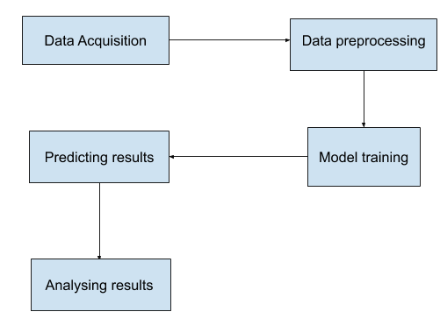
ARCHITECTURE

Slide 6
RELATED WORK
https://www.irjet.net/archives/V6/i3/IRJET-V6I393.pdf
https://arxiv.org/ftp/arxiv/papers/1711/1711.10377.pdf

Slide 7
NOVELTY OF THE WORK
Twitter messages is that it includes rich structured information about the individuals involved in the communication
Leads to more accurate tools for extracting semantic information
Provides means for empirically studying properties of social interactions
Allows us to gain an overview of the wider public opinion behind certain topics
Shifts in sentiment on social media have been shown to correlate with shifts in the stock market
Overall customer experience of users can be revealed quickly with sentiment analysis

Slide 8
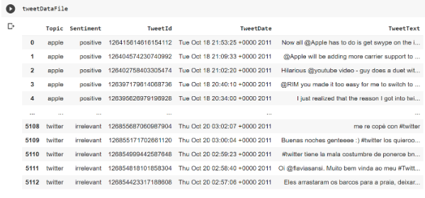
DATA COLLECTION AND PREPARATION
The corpus used in this case study is Niek Sanders’ Corpus of over 5000 hand-classified tweets. Being hand-classified makes this corpus quite reliable to evaluate the training models.

Slide 9
IMPLEMENTATION

Slide 10
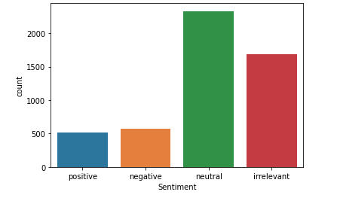
VISUALISATION
The corpus has 4 sentiment labels - positive, negative, neutral, irrelevant
COUNT PLOT ON SENTIMENT COLUMN

Slide 11
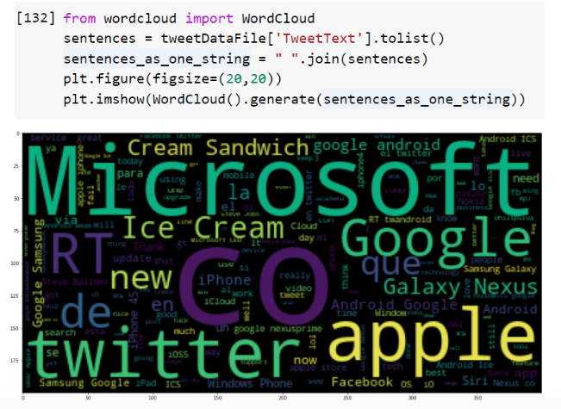
WORD CLOUD VISUALISATION
A Wordcloud (or Tag cloud) is a visual representation of text data. It displays a list of words, the importance of each being shown with font size or color.
WORD CLOUD VISUALISATION
A Wordcloud (or Tag cloud) is a visual representation of text data. It displays a list of words, the importance of each being shown with font size or color.

Slide 12
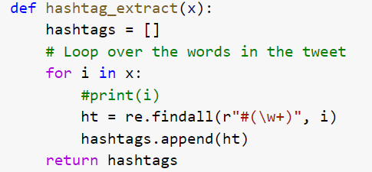
HASHTAG ANALYSIS
Separating the hashtags of each tweet based on the sentiment of the tweet and plotting it in the form of couplot gives the following visualisations. This form of analysis can be used to see which hashtags are associated with positive sentiment or negative sentiment and how much are they associated at a quick glance.

Slide 13
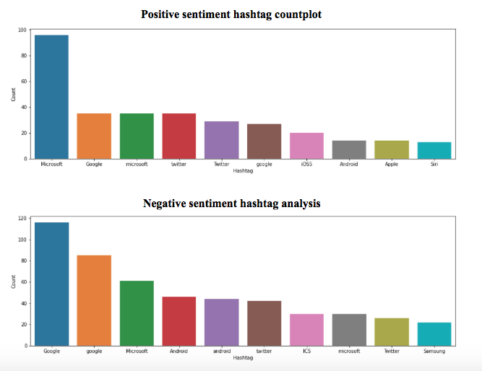

Slide 14
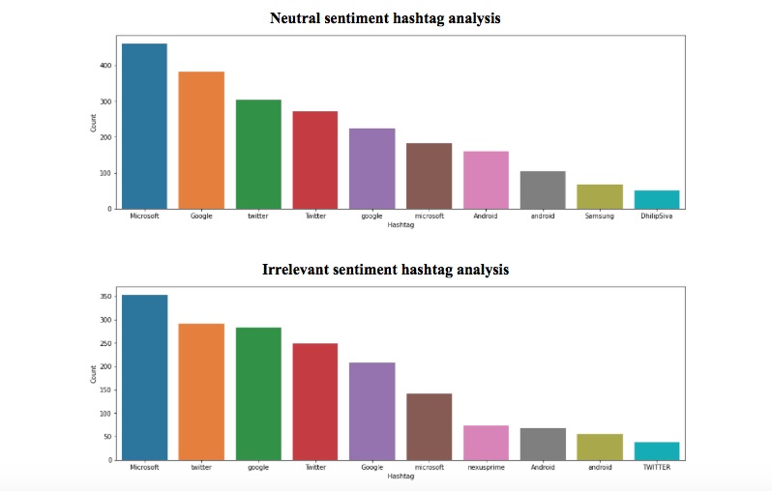

Slide 15
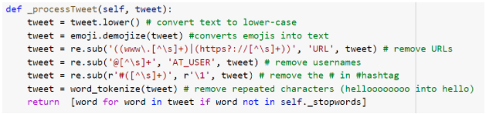
PREPROCESSING THE DATA

Slide 16
For example:
Original - "@person1 retweeted @person2: Yippee with corn is the mooooostttt delicious!!!! 🤤 #corn #yippee #yummy ..."
pre-processor result - “AT_USER rt AT_USER Yippee with corn is the most delicious! :drooling_face: corn yippee yummy”
Tokenization - [“yippee”, “with”, “corn”, “most”, “delicious”, “:drooling_face:”, “corn”, “yippee”, “yummy”]

Slide 17
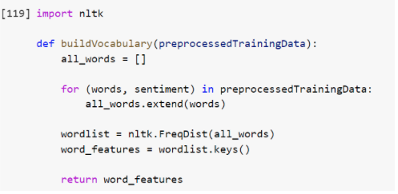
BUILDING VOCAB AND EXTRACTING FEATURES
A vocabulary is a list of all speech segments available for the model. This includes all the words in the Training set.
Notes:
The following snippet is just creating a list of all_words we have in the Training set, breaking it into word features. These word_features are a list of distinct words, each of which has its frequency as a key.

Slide 18
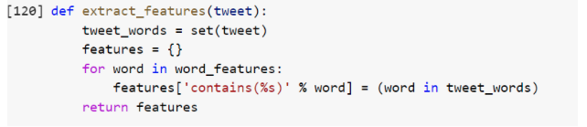
This function matches the tweets against the developed vocabulary.
The NTLK built-in function apply_features does the actual feature extraction from our lists.
Notes:
For every word in the word_features, we will have a key ‘contains word X’, where X is the word. Every key of those will have the value True/False, — True for ‘present’ and False for ‘absent’.
Applying nltk.classify.apply_features provides word feature vectors which can be plugged into the Naives Bayes Classifier.

Slide 19
TRAINING THE CLASSIFIER
The word feature vectors produced are passed to the inbuilt NLTK Naives Bayes Classifier.

Slide 20
RESULTS

Slide 21
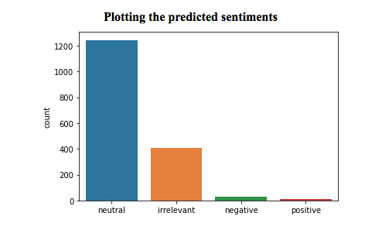
RESULTS
Running the classifier and calling the classify function with the test data set, gives the predicted labels.

Slide 22

PERFORMANCE EVALUATION AND DISCUSSION
Confusion matrix is used to visualise the predictions. Accuracy, precision, recall and f1-score are used to evaluate the model using the predicted labels and the original labels.

Slide 23
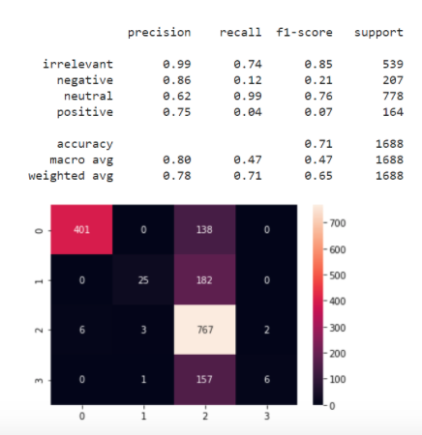

Slide 24
FUTURE ENHANCEMENTS
Instead of trying to predict the sentiments of tweets from the dataset, real time tweets can be pulled from twitter with the help of tweepy package.
Predicting the sentiment of such tweets and analysing them can provide us real time insights on the hashtags or trends on twitter.

Slide 25
REFERENCES
https://www.coursera.org/learn/twitter-sentiment-analysis/home/welcome
https://towardsdatascience.com/creating-the-twitter-sentiment-analysis-program-in-python-with-naive-bayes-classification-672e5589a7ed
https://www.earthdatascience.org/courses/use-data-open-source-python/intro-to-apis/analyze-tweet-sentiment-in-python/

